Slide 1
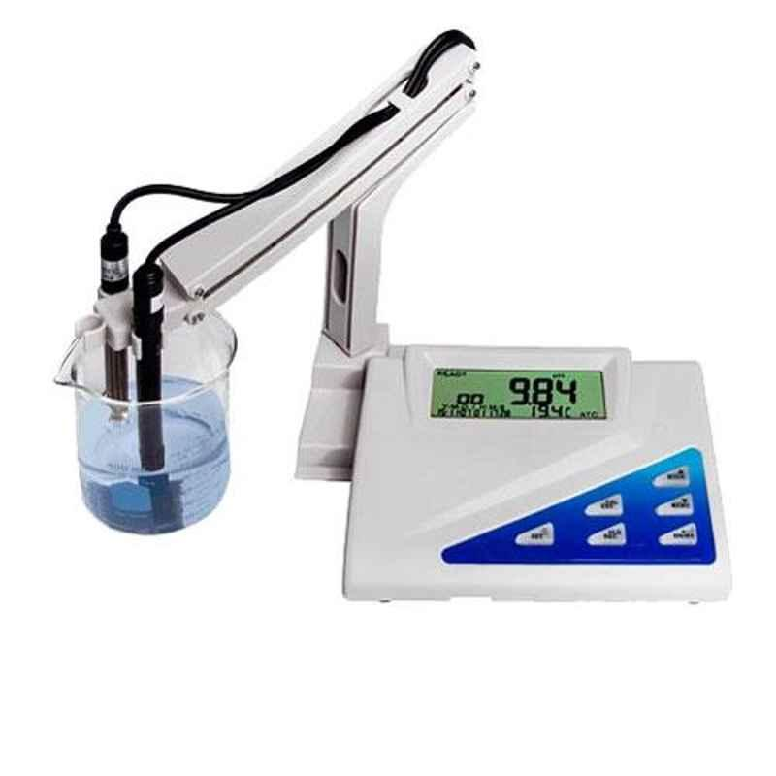
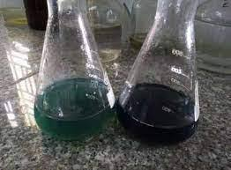
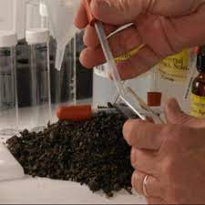
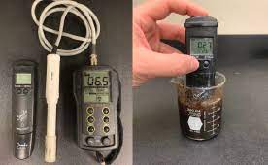
Determination of Soil pH, EC and OM
Dr. Vikas Abrol
Professor, Division of Soil Science and Agriculture Chemistry
Sher-e-Kashmir University of Agricultural Science and Technology of Jammu, Chatha

Slide 2
Determination of pH
Weigh 20 g of air dried soil passed through 2 mm sieve and transfer to a clean 100 ml beaker and add 50 ml of distilled water (1: 2.5 ratio).
Add 50 ml of distilled water (1: 2.5 ratio).
Using glass rod, stir the content intermittently and allow it to stand for half an hour.
Wash the electrodes carefully with a jet of distilled water and wipe it dry with a piece of filter paper.
Stir the soil suspension again just before taking the reading.
Immerse the electrodes into the beaker containing soil water suspension and change the function switch to the particular pH range.
Record the meter reading.

Slide 3
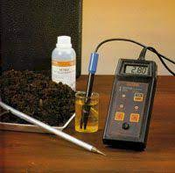
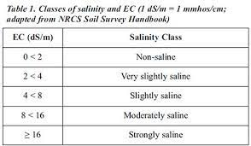
Determination of Electrical Conductivity
Switch on the conductivity bridge and wait for 10 minutes.
Use the same soil water suspension used for measuring pH for the determination of EC.
Stir the contents and allow the soil to settle.
Wash the electrodes carefully and immerse them into soil solution.
The readings on the scale at this position indicate the electrical conductivity.

Slide 4
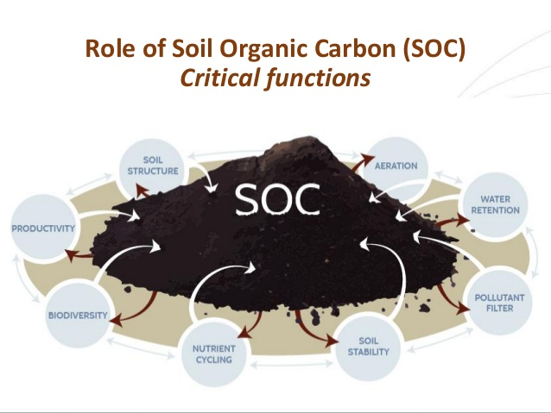
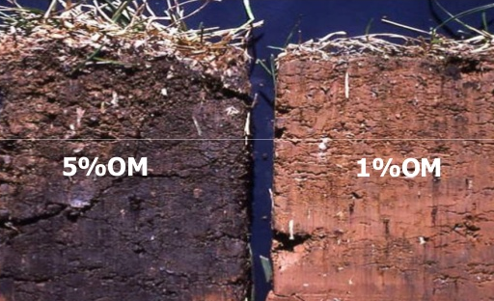
Determination of Soil Organic Matter
Weigh 1.0 g soil and transfer it in a dry 500 ml conical flask.
Add 10 ml 1N K₂Cr₂O₇ using pipette and swirled the flask a little.
Add 20 ml concentrated H₂SO₄ (containing 1.25% Ag₂SO₄) and swirl it 2-3 times.
The flask is allowed to stand for 30 minutes and then add 200 ml distilled water.
Add 10 ml phosphoric acid and/or 0.5 g NaF and 1 ml diphenylamine indicator.
Titrate the contents of flask with 0.5N FAS solution.
Add FAS solution freely from burette until the contents of flask changes blue-violet to green or dull green, thereafter; start adding it slowly drop by drop until colour turn to chocolate red.
Simultaneously, a blank is run without soil.

Slide 5
Calculations
Organic Carbon
Interpretation
Low | Medium | High
<0.50 % | 0.50-0.75% | >0.75%

